Slide 1
Azure App Service
Azure App service is a platform as a service which used to deploy code and containers
Code: Java, python, Node, .NET and PHP
Container: Window’s and Linux

Slide 2
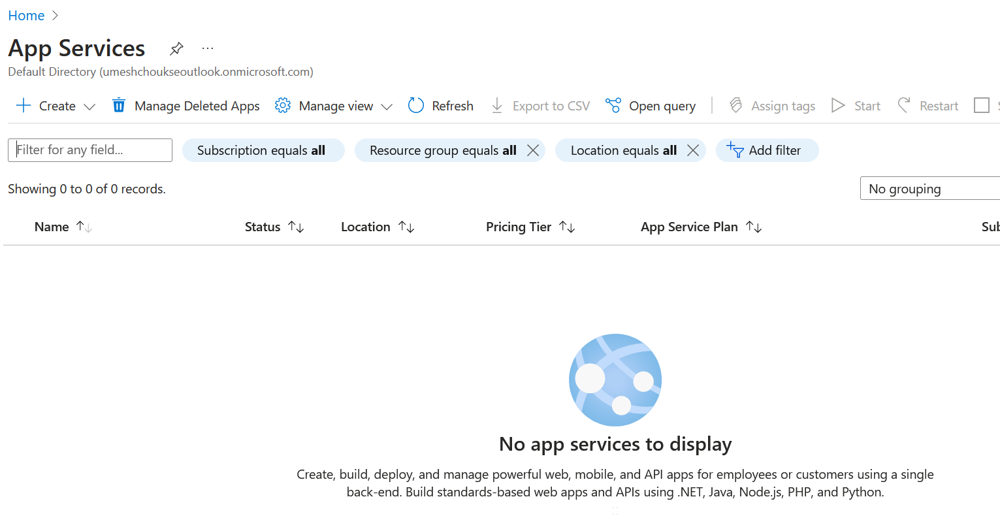

Slide 3
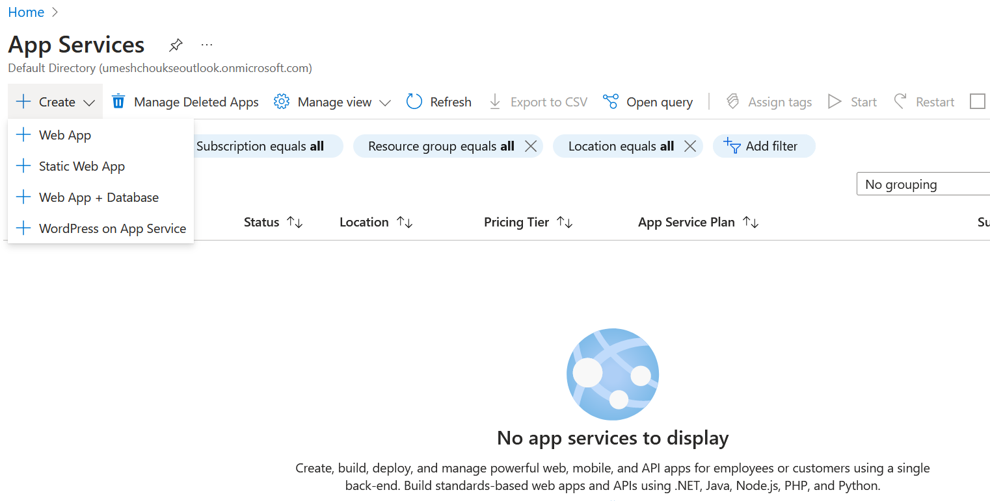

Slide 4
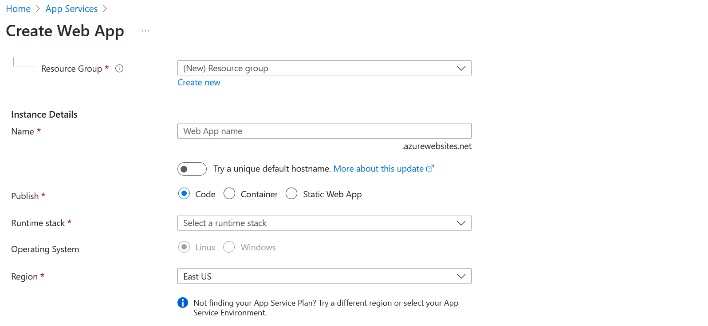

Slide 5
Azure App Service Plan
How Azure would be charging money to you if you use azure webapp

Slide 6
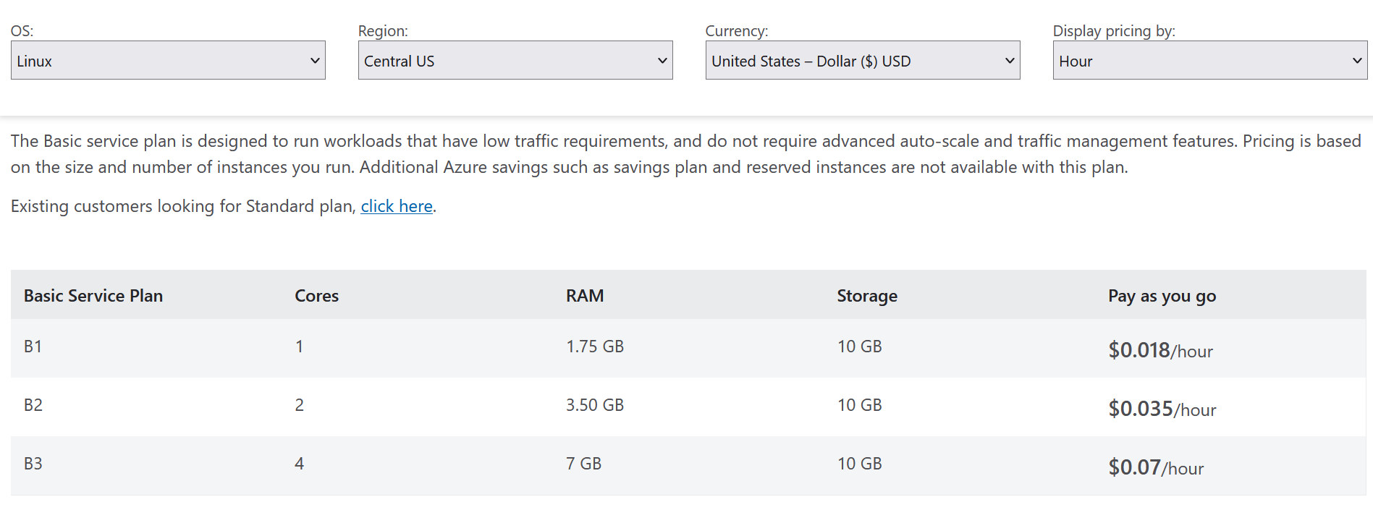

Slide 7
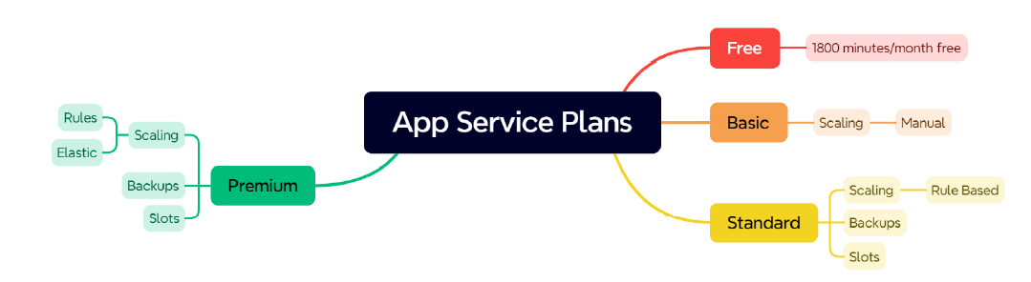
App Service Plan type

Slide 8
